Slide 1
Principles of Programming Assessment 3
Transportation Logistics System
Presented by: Amira Nadira, Jayllan and Ramit

Slide 2
01
Introduction

Slide 3
1. Purpose of the task
Main goal of this task was to build a transportation logistics system using Object- Oriented Programming (00P) principles in Python.
The provides a comprehensive fleet management system that manages vehicles, customers, shipments, and deliveries. It allows a company to handle its logistics operations, including adding and updating vehicles, managing customer information, creating shipments, and tracking deliveries.

Slide 4
2. Problem Solving
This system addresses the logistical challenges faced by companies that manage a fleet of vehicles for transporting goods. It helps streamline operations by providing functionalities to:
Fleet Management: It allows users to manage the company's fleet of vehicles by adding new vehicles, updating their information, removing them from the system, and viewing a list of all vehicles.
Customer Management: The system enables the management of customer records, including adding new customers, updating their details, removing customers, and viewing a list of all customers. It also allows users to view shipments associated with specific customers.

Slide 5
2. Cont…
Shipment Management: The code handles the creation of shipments, tracking of shipment status, and viewing of all shipments. This helps in ensuring that logistics operations are running smoothly and that shipments are properly tracked from origin to destination.
Delivery Management: The program allows users to mark shipments as delivered and view the delivery status of shipments. This feature is crucial for confirming the completion of delivery processes and ensuring customer satisfaction.

Slide 6
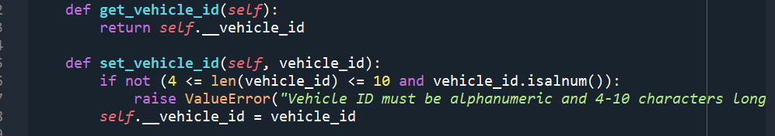
3. OOP Principles Applied
Encapsulation
- Private Attributes: The classes use private attributes (e.g., self.__vehicle_id) with getter and setter methods to control access and modifications.
- This prevents direct access to sensitive attributes and enforces validation rules.

Slide 7
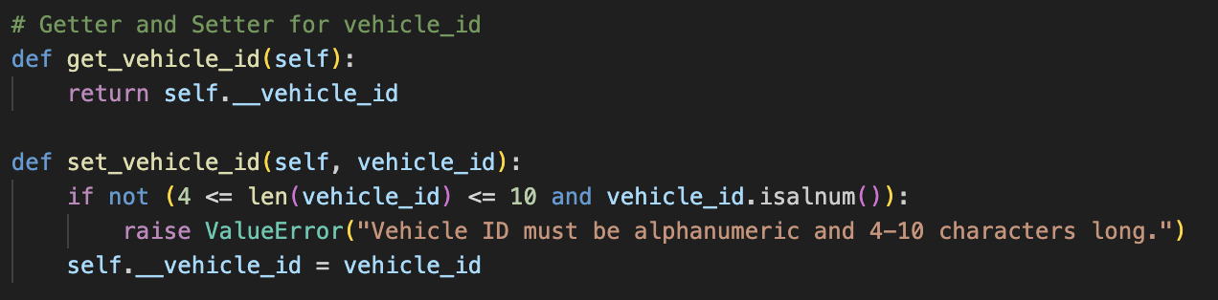
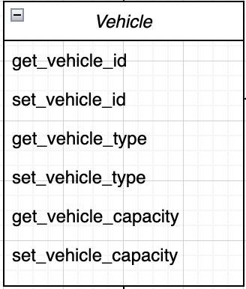
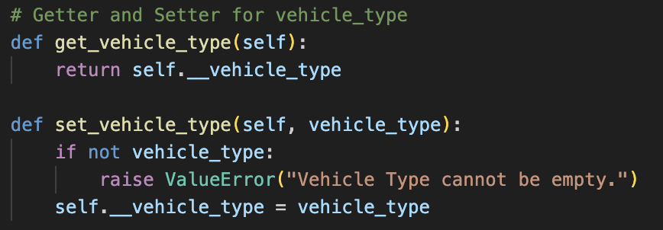
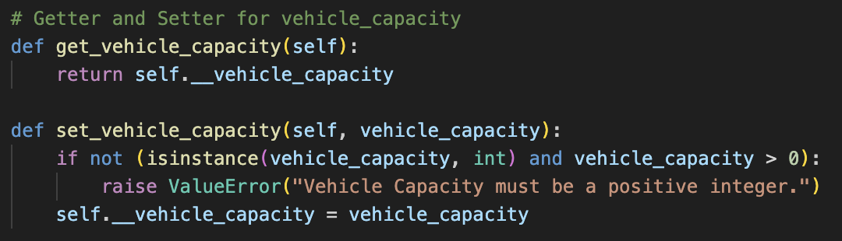

Slide 8
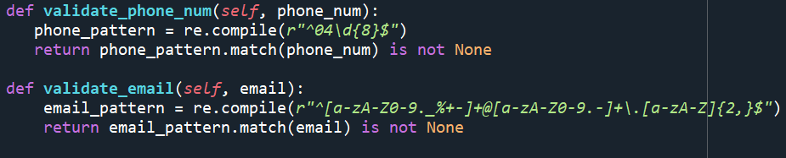
Validation and Error Handling
Example: The ‘CustomerManagement’ class ensures data integrity by validating customer information before it is added or updated. This follows the principle of encapsulation, as the class controls how data is accessed and modified.

Slide 9
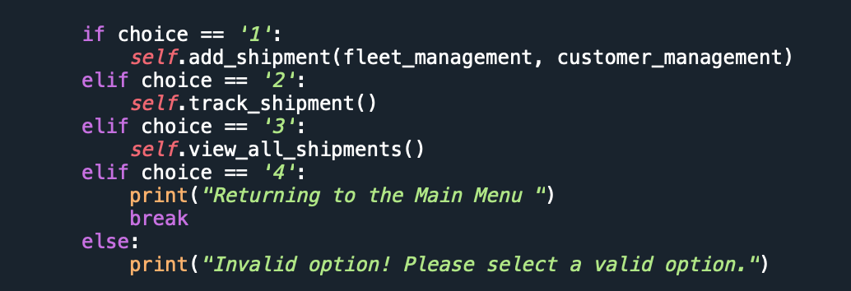
Invoking methods
Methods defined in a class can be invoked on instances of that class

Slide 10
print_values Method in the Customer Class
Allows the user to see a list of all customer in this system.

Slide 11
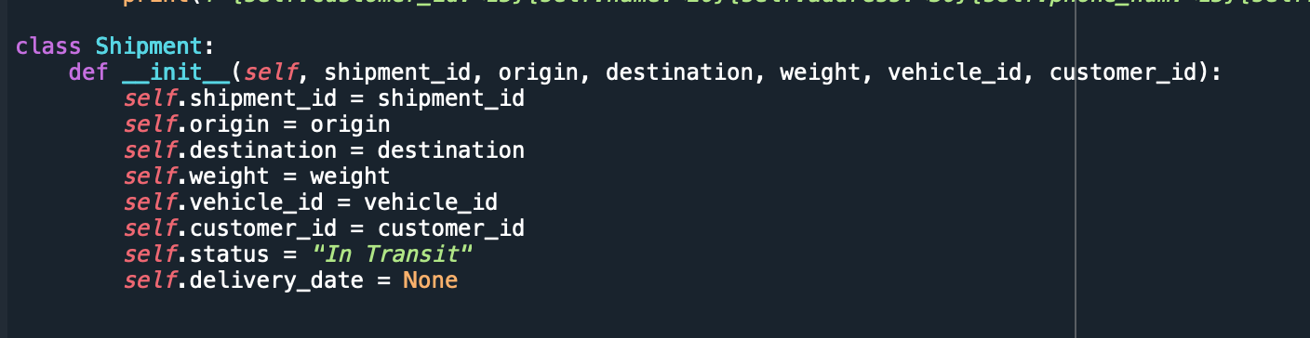
Defining Classes and Creating Instance

Slide 12

Teamwork and Communication
Discussion
Teamwork
Use whatsapp group
Divide task as per agreed
Make a regular meeting to check the code
Brainstorming and helping each other on giving idea to solve problem
Double-check on other work
Testing and review the code

Slide 13
Role in develop the system
Jayllan
Amira Nadira
Ramit
Develop and implement Fleet Management
Design Class Diagram
Develop and implement Customer Management
Documentation
Develop and implement Shipment and Delivery Management

Slide 14
Thank You!

